Slide 1
Databases/Database Plus
What is Database Plus?
How and When to use it?
Database Plus is a tool for programmers to amend and configure the new sample tracker database within 4.1. It is our new standard for databases which are linked to applications.

Slide 2
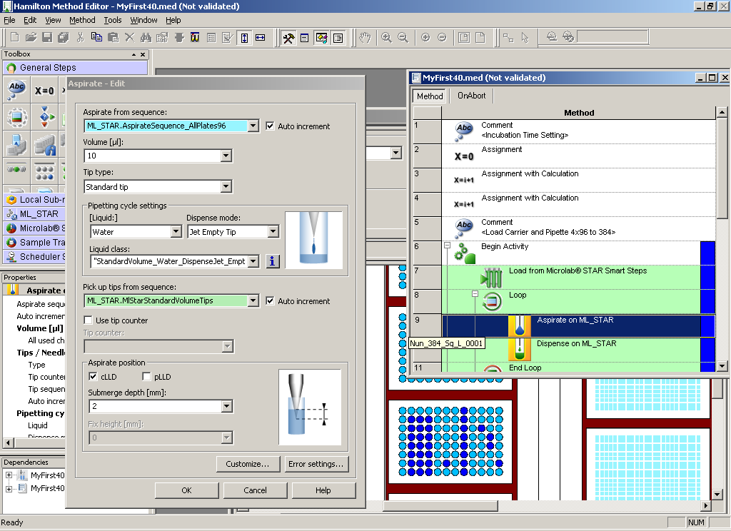
Vector 4.1

Slide 3
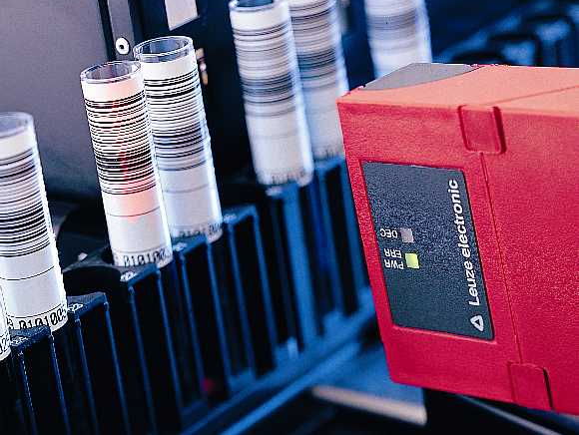


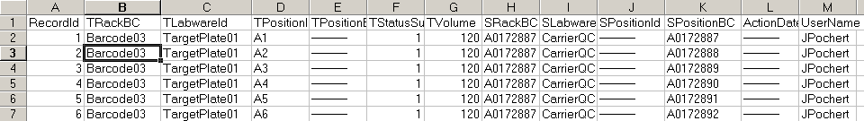
Vector Database: Sample Tracking
Target
Create
Report
Source
Target Well Information
Source Well Information

Slide 4
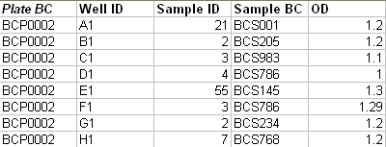

Vector Database Plus
Local or Remote (TCP/IP)
Track Information
Tracking over multiple runs
Support of Remote DBs
Includes Results from
Measurements (OD, etc.)
Run 1
Run 2
Database
Plus
Run …

Slide 5
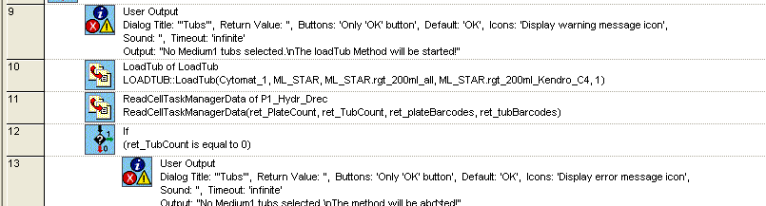
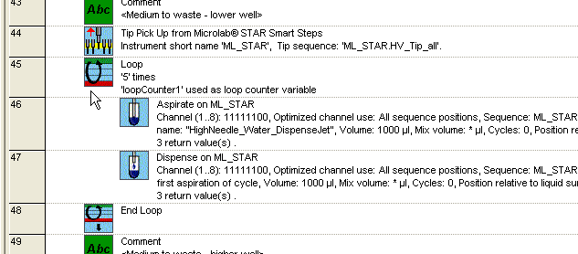
Keep Methods Simple
Software <= 4.0
Software 4.1

Slide 6

Benefits of Database Plus
Standardization on ONE Tool, Maintenance of Methods
Methods Stay Simple
Customizations (Readouts, Applicative Data, etc.)
Flexible Reports (Standard Functions or SQL-based)

